Slide 1


Pack 140
Popcorn Kickoff

Slide 2
Our Goal
We Sold $14,144 Last Year !
Our Goal for This Year: $16,000!!
To Pay For A Great Scouting Program !!
Notes:
Find more information at trails-end.com.

Slide 3
How Do We Do It?
Show & Sell $ 2,500
40 Scouts Sell $350 each = $14,000
$16,500
Each Scout’s Sales Goal This Year: $350
Notes:
Find more information at trails-end.com.

Slide 4
$75 Make The Pack Go Donation
**If you choose not to sell popcorn you must make a $75 Make the Pack Go Donation to cover your scout’s Pack costs.
**Or, say you only sell $100 worth of popcorn, you must make up the difference with a donation.
For example - sell $100 @ 37% commission = $37
you add $38 to make up the difference to $75

Slide 5
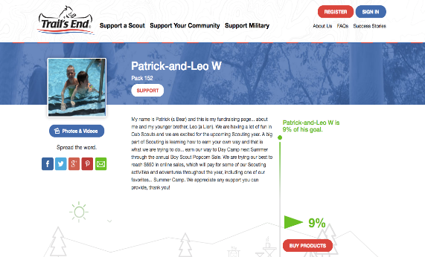

Online Sales Raise More Money In Less Time with Less Effort
Makes Selling Easy as 1, 2, 3!
Register your account
Personalize your selling webpage
Share with family & friends via email, text message, Facebook, Twitter & more
*The average online sale in 2016 was $62 vs. $18 selling Face-to-face!
Notes:
Show this slide – and then actually Register an online page rather than showing this slide (emphasize easy and quick)

Slide 6


OUR SHOW & SELL - PLEASE HELP!!

Slide 7
Take & Sell – New for 2018
Sell door to door and deliver product at the same time
This is an experiment for 2018 and will be limited to 10-15 scouts
Email Adam Leone at ajleone@gmail.com if interested
This will require organization and communication.
Hopefully it increases sales!
Notes:
Find more information at trails-end.com.

Slide 8
How to Speak with Customers
Hi, my name is _______________ (say first name only).
I’m a Scout with Pack 140 here in Ringwood.
I am trying to earn my way to Camp Lewis and support our programs.
I have many DELICIOUS flavors of popcorn, and ____ is my favorite because ______!
(Hand the customer the order form and a pen, and point out your favorite flavor. Consider recommending a $20 or more item.)
Can I count on your support to help fund my adventures?
Practice, practice, practice!
The most successful sellers can recite this in their sleep.

Slide 9
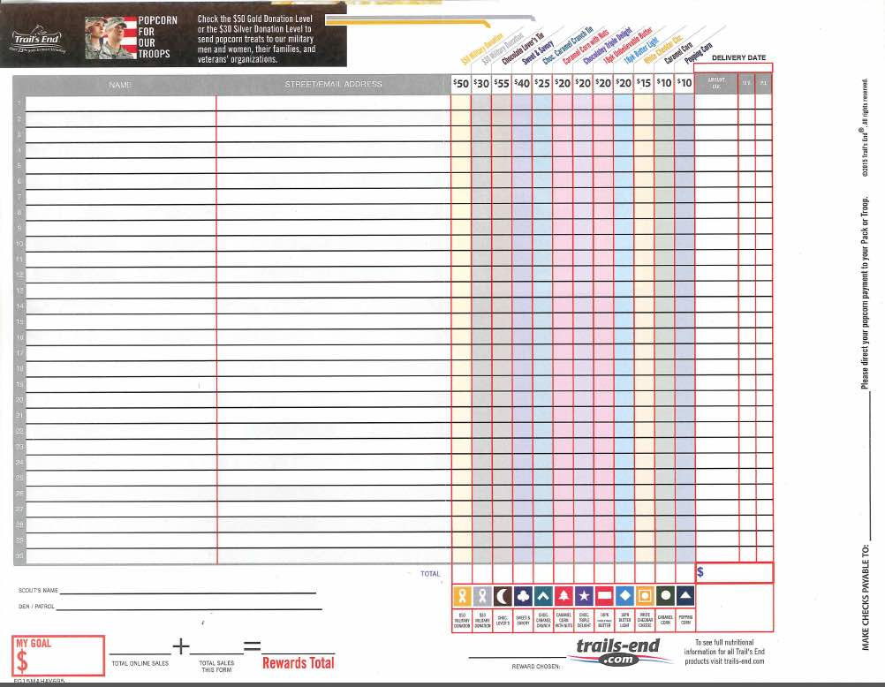
Please Fill Out Your Order Form Correctly !!
Write Legibly
Put Your Name on Order Form
Add Up The Total
Choose Your Prize
Make checks payable to:
The Community Church of Ringwood Pack 140

Slide 10
Key Dates
Take & Sell Popcorn Pickup: September 30th
Harvest Fest Show-n-Sell: October 13th-14th
Take & Sell Popcorn Return: October 21st
Orders & Money Due: October 21st
Popcorn Pick Up: November 10th

Slide 11
Does Anyone Want Prizes?

Slide 12
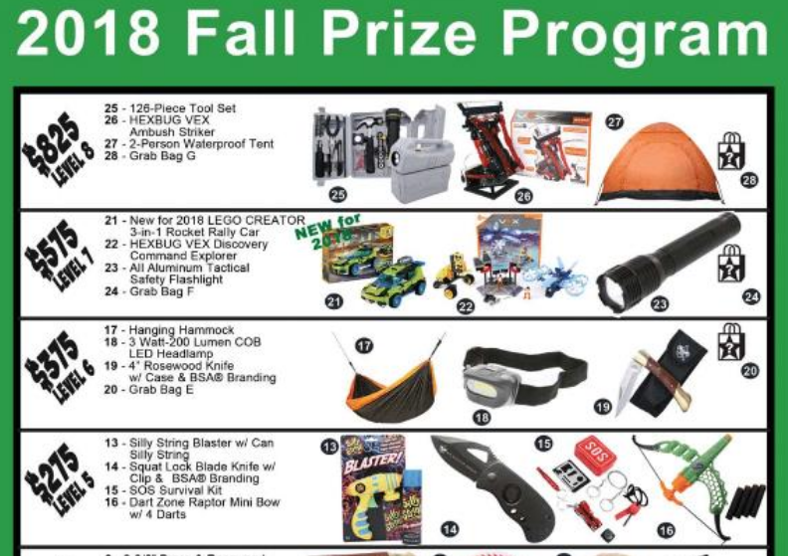
Traditional Prizes

Slide 13
For Every $100 In Sales…
Earn 1 Ticket in a Drawing for a Drone !!
So each Scout that sells the minimum will earn 1 ticket.
Sell $300 and receive 3 chances to win!!
Make the Pack Go donations do not qualify
* All sales count towards totals for raffle entries

Slide 14
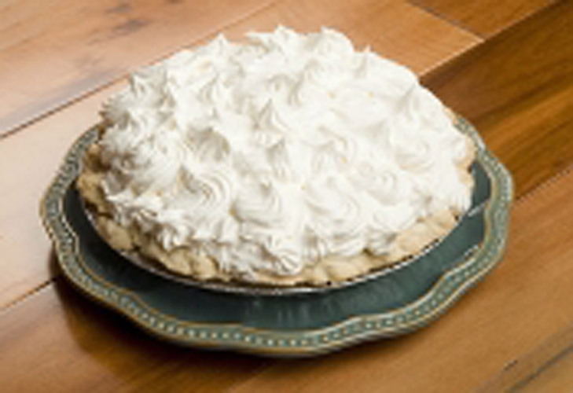
Sell $600
Throw a PIE in the Popcorn Kernel’s face!
(or maybe your Den Leader’s)
* Sales from Take Orders, Take & Sell, and online count. Credit for Harvest Fest Show & Sell does not apply.

Slide 15

Sell $1,000
win 2 tickets to a private screening of …
* All sales count towards totals for raffle entries

Slide 16
Exceed your $350 Goal
Earn a credit of 10% of your excess towards your scout activities
Example
A scout sells $500, $150 above their goal
A credit of $15 (10% of $150) can be used for pack expenses such as the winter or spring campout
The Fine Print
Sales from Take Orders, Take & Sell, and Online count. Harvest Fest sales do not
Credits cannot be used for the fall campout in November
Credits will not be “refunded” if they exceed actual costs

Slide 17
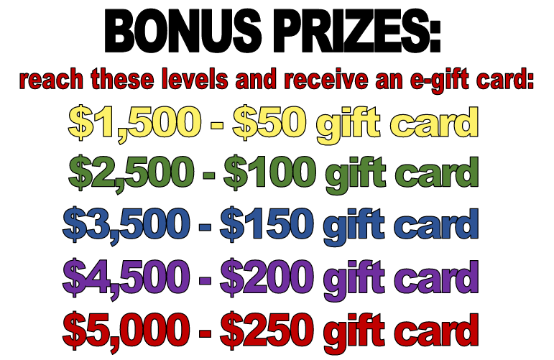
Bonus Prizes – Take Orders
* These bonus prizes are for Take Order, Take & Sell and Show & Sell sales only. Online sales do not count as these prizes are from the NNJ Council.

Slide 18

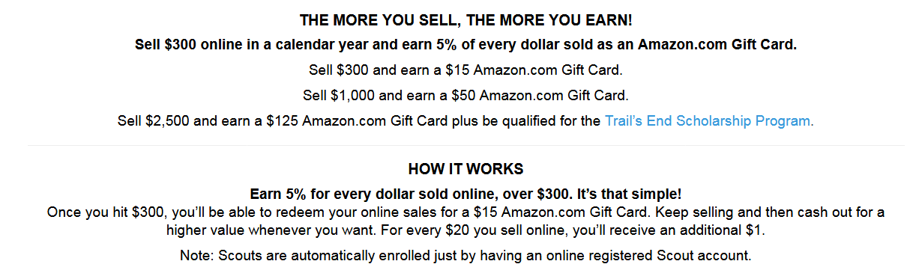
Bonus Prizes – Online Sales

Slide 19
Confused? What counts for what?

Slide 20
Example
Take Order Sales of $400, $100 “credit” for Harvest Fest, and Online Sales of $200. Total sales of $700.
Traditional incentive prize level of $500
Credit of $25 toward pack activity expenses ($600 Sales - $350 Goal x 10%)
7 entries to the raffle drawing
Pie Face!

Slide 21
Example
Take Order Sales of $650, $100 “credit” for Harvest Fest, and Online Sales of $300.
Total Sales of $1,050
Traditional incentive prize level of $750
Credit of $60 toward pack activity expenses ($950 Sales - $350 Goal x 10%)
10 entries to the raffle drawing
Pie Face!
2 Tickets to premiere of Spiderman movie
$15 Amazon gift card for online sales

